Slide 1
B09S0061 Software Engineering
Lecture 9
Instructor: Liu, Guangchi Ph.D.
2025/04/25
Notes:
本模板基于“中国科学院大学-路人丁-PPT模板”魔改而成，著作权归该作者所有。
本模板中使用的东南大学校徽、校标文字组合、校训文字等素材来自于微信公众号“金木屋”。
本模板的视觉设计参考了“东南大学视觉识别系统”。
人物介绍页头像素材来自 小肥柴。
本模板力求简洁，布局合理，主次分明。以学术风为设计理念，适用于学术报告与论文答辩等相关应用场景。模板未使用任何动画效果。
您仅可以以个人非商业用途使用本PPT模板，不可将信息内容的全部或部分用以出售，或以出租、出借、转让、分销、发布等其他任何方式供其他人使用。
欢迎 持续关注东南大学止于至善学术风 PPT 模板 （https://zhuanlan.zhihu.com/p/335298500）后续的功能优化及多语言更新版本。
最后，祝汇报顺利，马到成功！
Version: (2021) v1.5-en.

Slide 2
Heads Up
3rd Assignment: will be released on May 5th (Monday), 23:55 pm, Due on May 12nd (Monday), 23:55 pm

Slide 3
Heads Up
2nd Lab: Apr 26th (Saturday), 14:00 – 17:25, J6-101 (Lecture Classroom)
Each team will take your laptop and present to TA or Instructor:
User Experience Design
System Architecture
Specific design for security
Specific design for performance

Slide 4
Heads Up
Prepare the following questions (10 pts for each question )
Q1 Have your designed any paper prototype/wireframe/mock-up/operational prototype for the frontend of your project ?
Q2 What are the MVC components (if any) of your frontend?
Q3 What is your plan for evaluating/testing the user experience of your project?
Q4 What is the component diagram of your project like?
Q5 What is the deployment diagram of your project like?
Q6 What is the package diagram of your project like?
Q7 Any plan of using virtualization technologies?
Q8 Any possible security risk in your project? How will you minimize them?
Q9 What will the peak demand/capacity of your product be in the future?
Q10 Based on the potential demand/capacity, any performance bottleneck in your project? How will you improve them?

Slide 5
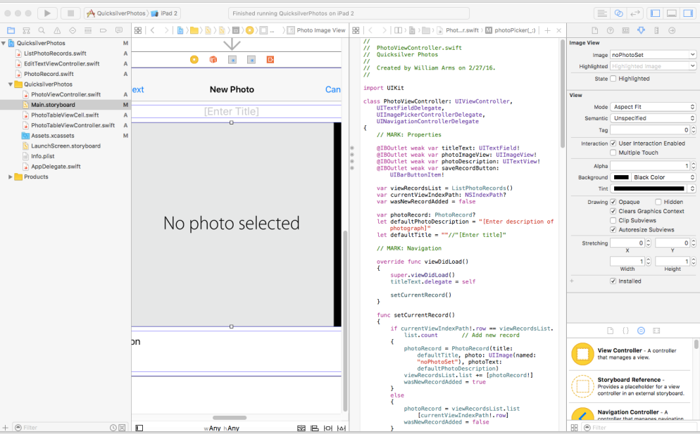

Slide 6
Advanced Development Environments
An advanced development environment is intended to provide everything that a developer needs.
The developer is expected to follow the program choices that are provided.
For example, when Xcode is used with iOS it has a very specific purpose: mobile apps for Apple devices such as iPhones, iPads.
Special programming language (Swift or Objective C)
MVC framework
If you accept the overall program design it is very powerful:
Auto layout of graphical interfaces
Comprehensive set of classes for user interfaces and navigation
Simulators for all Apple devices

Slide 7
Using Development Frameworks
Development frameworks are powerful and flexible.
If your application fits the framework, they do much of the program design and provide high quality code for many of the standard parts of any application.
Some parts of the application may need be designed separately.
But beware:
You are forced to build your application within the framework that is provided.
The frameworks are continually modified.
These frameworks are complex and take a long time to learn.

Slide 8
Production Programming
Murphy's Law:
If anything can go wrong, it will.
Challenges:
Code has to be maintained over the long term, with different system software.
Interfaces will be used in new and unexpected ways.
Every possible error will eventually occur at the worst possible time (bad data, failures of hardware and system software).
There are likely to be security attacks.

Slide 9
Production Programming
Robust programming:
Write simple code.
Avoid risky programming constructs.
If code is difficult to read, rewrite it.
Incorporate redundant code to check system state after modifications.
Test implicit assumptions explicitly, e.g., check all parameters received from other routines.
Eliminate all warnings from source code.
Have a thorough set of test cases for all your code.
In a production environment, expect to spend longer on coding and tesMng than in an academic setting.

Slide 10
01
PART FOUR
Reuse and Design Patterns

Slide 11
Software Reuse
It is often good to design a program to reuse existing components. This can lead to better software at lower cost.
Potential benefits of reuse
Reduced development time and cost
Improved reliability of mature components
Shared maintenance cost
Potential disadvantages of reuse
Difficulty in finding appropriate components
Components may be a poor fit for application
Quality control and security may be unknown
Software Reuse -> Component Reuse (Architecture Level) -> Pattern Reuse (Program Level)

Slide 12
Evaluating Software
Software from well established developers is likely to be well written and tested, but still will have bugs and security weaknesses, especially when incorporated in unusual applications.
The software is likely to be much better than a new development team would write.
But sometimes it is sensible to write code for a narrowly defined purpose rather than use general purpose software.
Maintenance
When evaluating software, both commercial and open source, pay attention to maintenance. Is the software supported by an organization that will continue maintenance over the long term?

Slide 13
Reuse: Open Source Software
Open source software varies enormously in quality.
Because of the processes for reporting and fixing problems, major systems such as Linux, Apache, Python, Lucene, etc. tend to be very robust and free from problems. They are often better than the commercial equivalents.
More experimental systems, such as Hadoop, have solid cores, but their lesser used features have not been subject to the rigorous quality control of the best software products.
Other open source software is of poor quality and should not be incorporated in production systems.

Slide 14
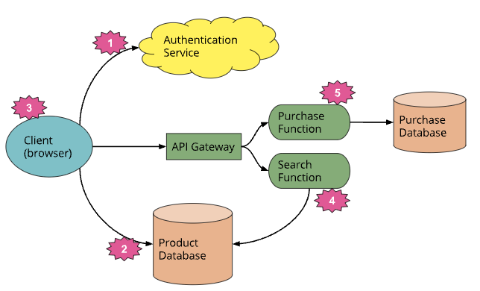
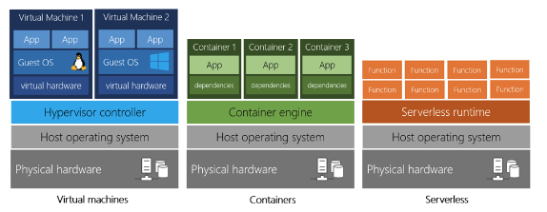
Evaluating Applications Packages
Applications packages for business functions are provided by companies like cloud providers. They provide enormous capabilities and relieve an organization from such tasks as updating financial systems when laws change.
They are very expensive:
Subscription fees to the vendor.
Modifications to existing systems and special code from the vendor.
Disruption to the organization when installing them.
Long term maintenance costs.
The costs of changing to a different vendor are huge.

Slide 15
Design for Change: Replacement of Components
The software design should anticipate possible changes in the system over its life-cycle.
New vendor or new technology
Components are replaced because its supplier goes out of business, ceases to provide adequate support, increases its price, etc., or because software from another source provides better functionality, support, pricing, etc.
This can apply to either open source or vendor (cloud) supplied components.
New implementation
The original implementation may be problematic, e.g., poor performance, inadequate back-up and recovery, difficult to troubleshoot, or unable to support growth and new features added to the system.

Slide 16
Design for Change: Replacement of Components
Additions to the requirements
When a system goes into production, it is usual to reveal both weaknesses and opportunities for extra functionality and enhancement to the user interface design.
For example, in a data-intensive system it is almost certain that there will be requests for extra reports and ways of analyzing the data.
Requests for enhancements are often the sign of a successful system. Clients recognize latent possibilities.

Slide 17
Design for Change: Replacement of Components
Changes in the application domain
Most application domains change continually, e.g., because of business opportunities, external changes (such as new laws), mergers and take-overs, new groups of users, new technology, etc.
It is rarely feasible to implement a completely new system when the application domain changes. Therefore existing systems must be modified. This may involve extensive restructuring, but it is important to reuse existing code as much as possible.

Slide 18
Design Patterns
Design patterns
Design patterns are template designs that can be used in a variety of systems. They are particularly appropriate in situations where classes are likely to be reused in a system that evolves over time.

Slide 19
Inheritance and Abstract Classes
Design patterns make extensive use of inheritance and abstract classes.
Classes can be defined in terms of other classes using inheritance. The generalization class is called the superclass and the specialization is called the subclass.
Abstract class
Abstract classes are superclasses which contain abstract methods and are defined such that concrete subclasses extend them by implementing the abstract methods. Before a class derived from an abstract class can be instantiated it must implement concrete methods for all the abstract methods of its parent classes.

Slide 20
Adapter (Wrapper): Wrapping Around Legacy Code
Problem description:
Convert the interface of a legacy class into a different interface expected by the client, so that the client and the legacy class can work together without changes.
This problem often occurs during a transitional period, when the long term plan is to phase out the legacy system.
Example:
How do you use a web browser to access an information retrieval system that was designed for a different client?

Slide 21
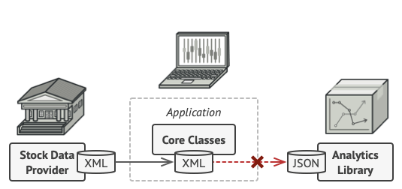
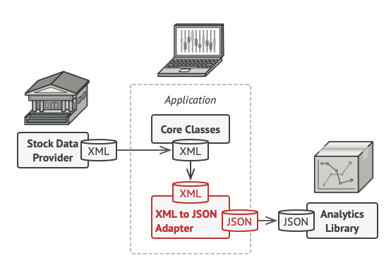
Adapter Design Pattern: The Problem

Slide 22
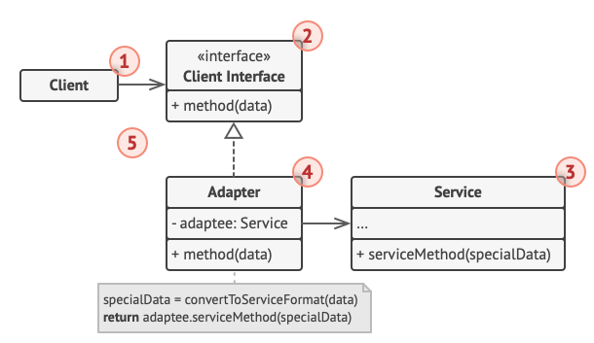
Adapter Design Pattern: Object Diagram
The Client is a class that contains the existing business logic of the program.
The Client Interface describes a protocol that other classes must follow to be able to collaborate with the client code.
The Service (Adaptee) is some useful class (usually 3rd-party or legacy). The client can’t use this class directly because it has an incompatible interface.
The Adapter is a class that’s able to work with both the client and the service.
Adaptee

Slide 23
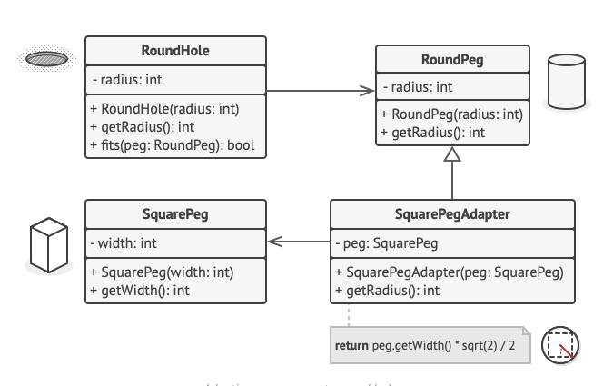
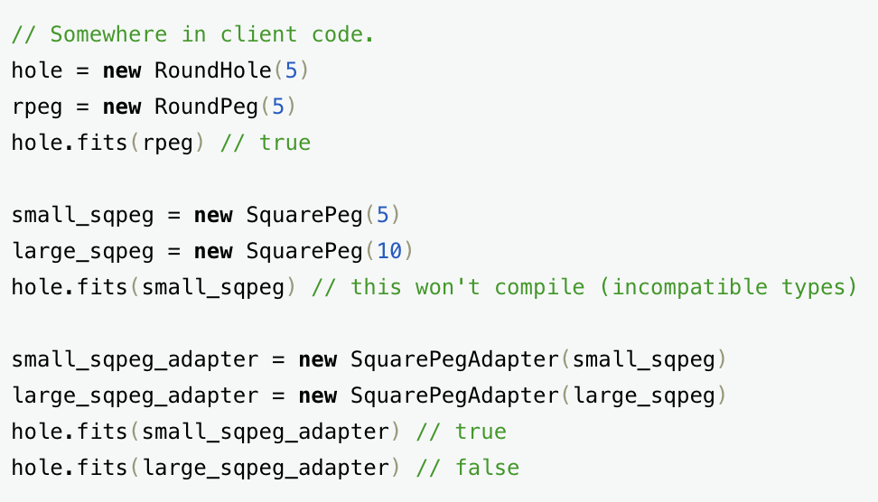

Slide 24
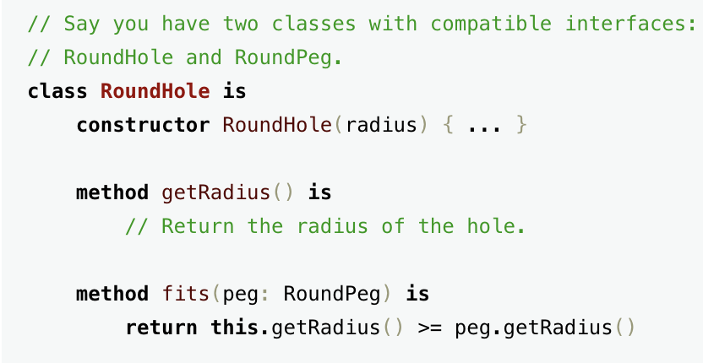
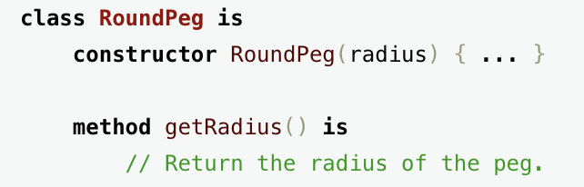

Slide 25
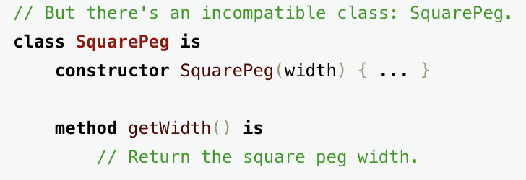
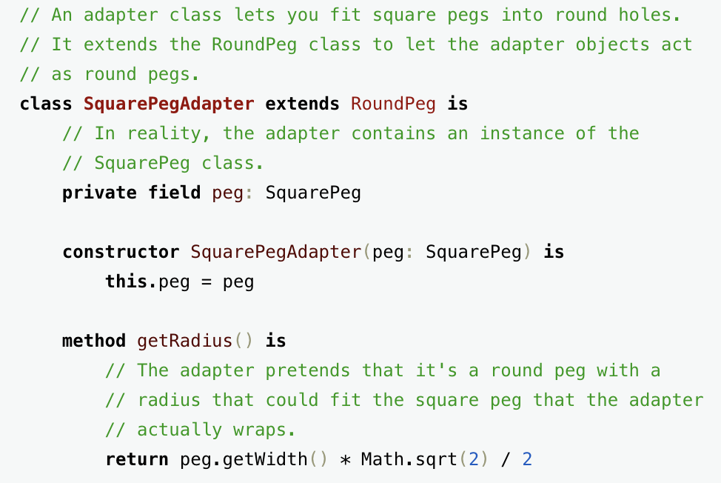

Slide 27
Adapter Design Pattern: Consequences
The following consequences apply whenever the Adapter design pattern is used.
Client and Adaptee work together without modification of either.
Adapter works with Adaptee and all of its subclasses.
A new Adapter needs to be written if Client is replaced by a subclass.

Slide 28
Bridge: Allowing for Alternate Implementations
Name: Bridge design pattern
Problem description:
Decouple an interface from an implementation so that a different implementation can be substituted, possibly at runtime (e.g., testing different implementations of the same interface).
Comparison of bridge and adapter design patterns
Bridge: defined interfaces that do not change
Adapter: legacy and new interfaces that have to work together

Slide 29
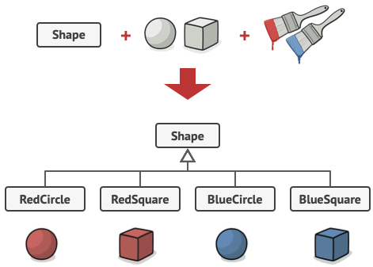
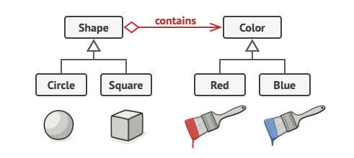
Bridge
Legacy
New

Slide 30
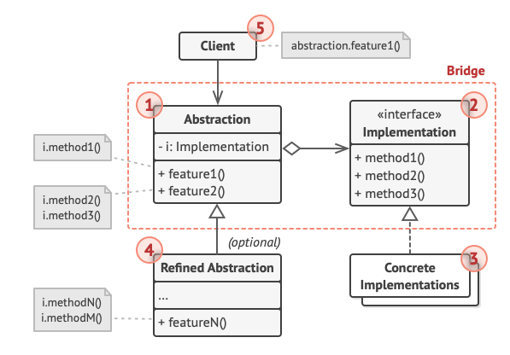
Bridge
The Abstraction provides high-level control logic. It relies on the implementation object to do the actual low-level work
The Implementation declares the interface that’s common for all concrete implementations. An abstraction can only communicate with an implementation object via methods that are declared here.
Concrete Implementations contain platform-specific code
Refined Abstractions provide variants of implementations via the general implementation interface.

Slide 31
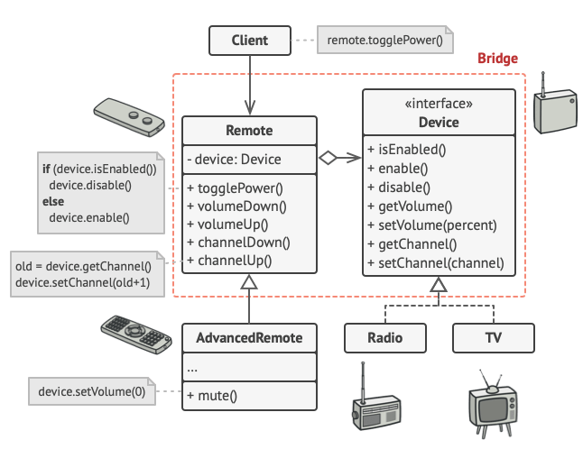
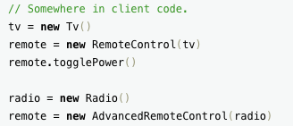

Slide 32
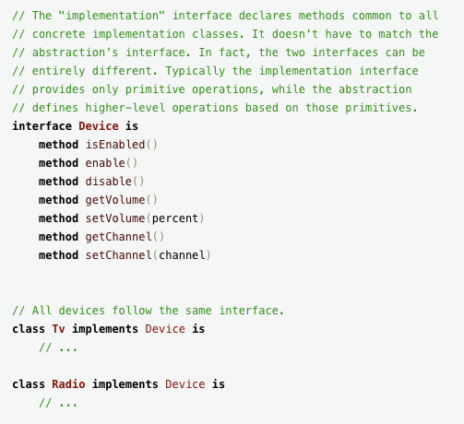
Bridge Example

Slide 33
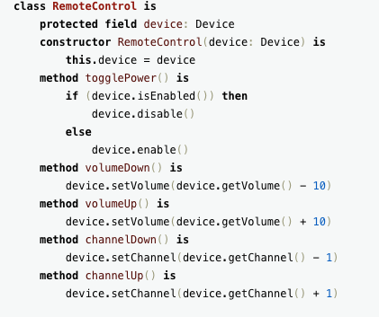
Bridge Example

Slide 34
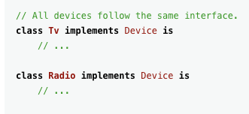
Bridge Example

Slide 35
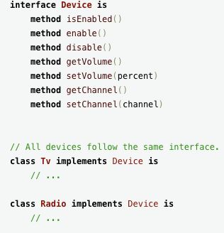
Bridge Example

Slide 36
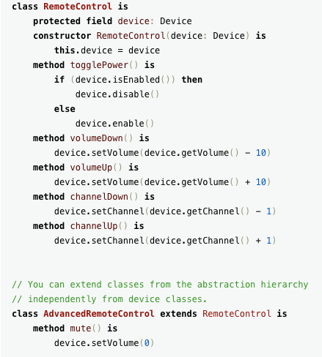
Bridge Example

Slide 37
Bridge: Allowing for Alternate Implementations
Solution:
The Abstraction class defines the interface visible to the client.
Implementor is an abstract class that defines the lower-level methods available to Abstraction.
An Abstraction instance maintains a reference to its corresponding Implementor instance.
Abstraction and Implementor can be refined independently.

Slide 38
Bridge: Consequences
Consequences:
Client is shielded from abstract and concrete implementations
Interfaces and implementations can be tested separately

Slide 39
Strategy: Encapsulating Algorithms
Name: Strategy design pattern
Example:
In a calculator, you need to build various operations (add, multiply, substract, divide, etc).
Problem description:
Decouple a policy-deciding class from a set of mechanisms, so that different mechanisms can be changed transparently.

Slide 40
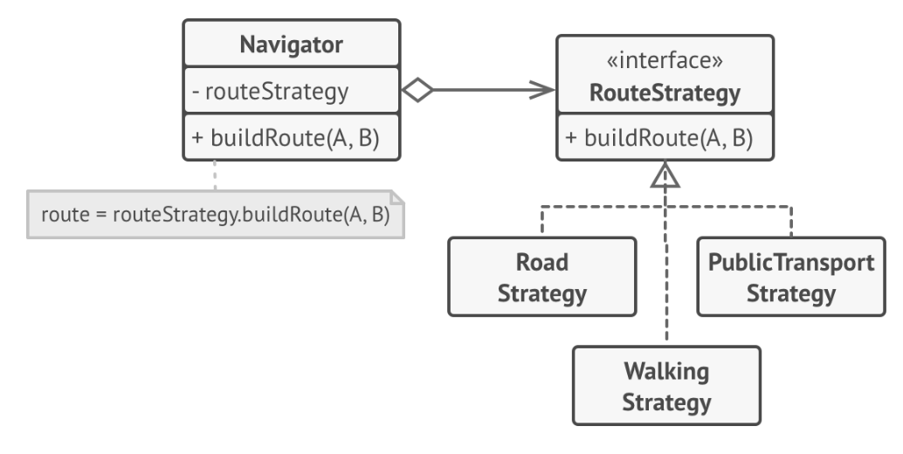
Strategy Example

Slide 41
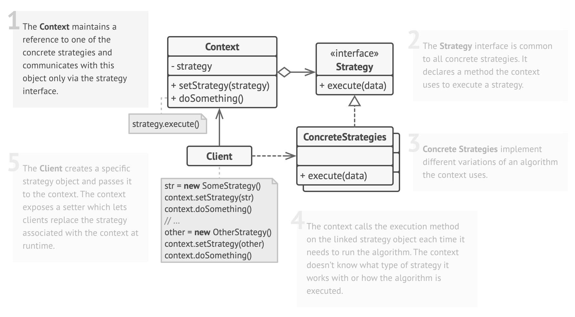
Strategy Example

Slide 42
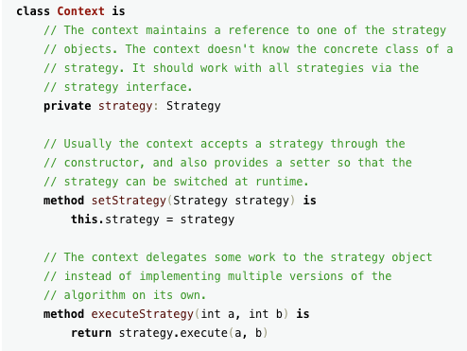
Design Pattern: Strategy

Slide 43
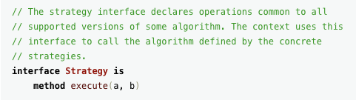
Design Pattern: Strategy

Slide 44
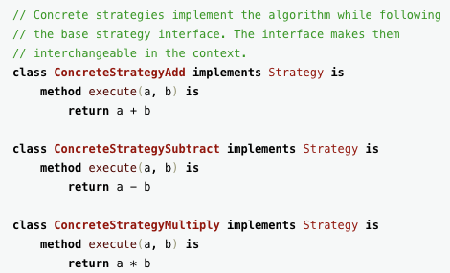
Design Pattern: Strategy

Slide 45
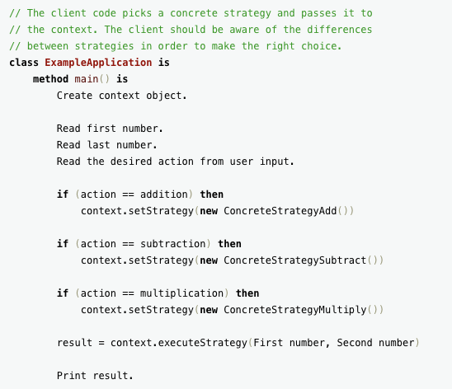
Design Pattern: Strategy

Slide 46
Strategy: Encapsulating Algorithms
Solution:
A Client accesses services provided by a Context.
The Context services are realized using one of several mechanisms
The abstract class Strategy describes the interface that is common to all mechanisms that Context can use.

Slide 47
Strategy: Consequences
Consequences:
ConcreteStrategies can be substituted transparently from Context.
Policy decides which Strategy is best, given the current circumstances.
New policy algorithms can be added without modifying Context or Client.

Slide 48
Facade: Encapsulating Subsystems
Name: Facade design pattern
Problem description:
Reduce coupling between a set of related classes and the rest of the system.
Example:
An audio player is composed of several decoder classes: MP3, WAV, OGG, etc. A caller invokes only the player (Facade) class, which invokes the contained classes.
Problem description:
A single Facade class implements a high-level interface for a subsystem by invoking the methods of the lower-level classes.

Slide 49
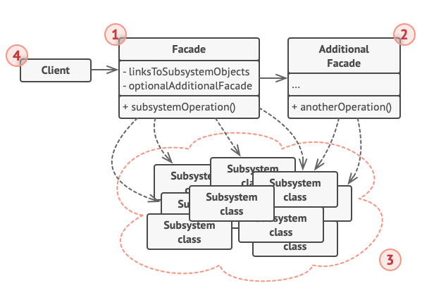
Facade
Convenient access to a particular part of the subsystem’s functionality
Additional Facade class can be created to prevent polluting a single facade
Subsystem classes aren’t aware of the facade’s existence
Client uses the facade instead of calling the subsystem objects directly

Slide 50
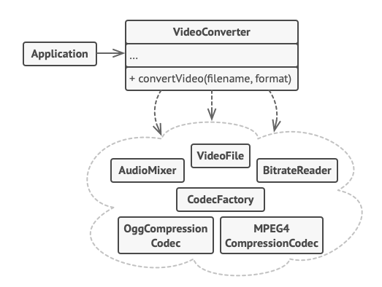
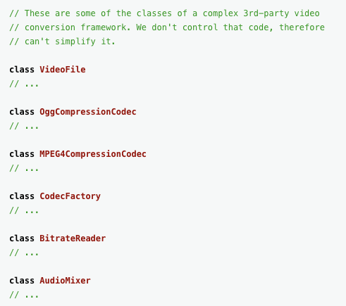
Facade

Slide 51
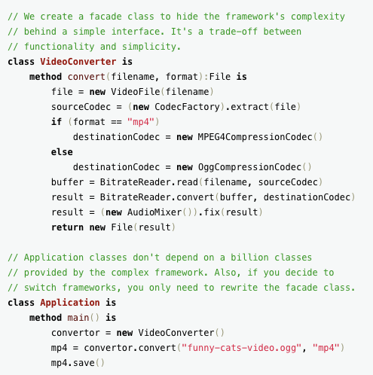
Facade

Slide 52
Facade: Consequences
Consequences:
Shields a client from the low-level classes of a subsystem.
Simplifies the use of a subsystem by providing higher-level methods.
Enables lower-level classes to be restructured without changes to clients.
Note. The repeated use of Facade patterns yields a layered system.

Slide 53
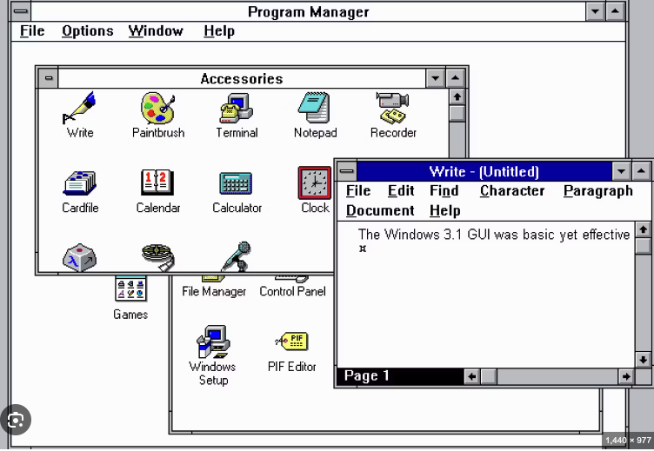
Composite: Representing Recursive Hierarchies
Name: Composite design pattern
Example: GUIs contained in a GUI
Problem description:
Represent a hierarchy of variable width and depth, so that the leaves and composites can be treated uniformly through a common interface.

Slide 54
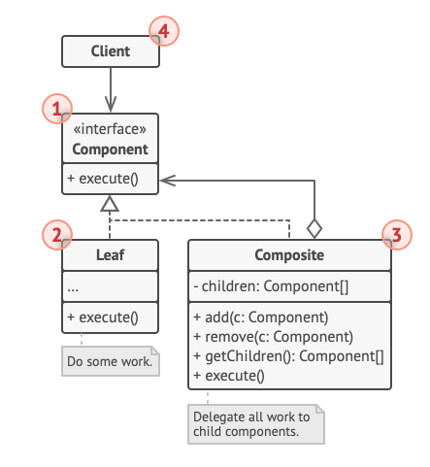
Composite: Class Diagram
The Component interface describes common operations
The Leaf is a basic element of a tree that doesn’t have sub-elements
The Container (aka composite) is an element that has sub-elements: leaves or other containers.
The Client works with all elements through the component interface

Slide 55
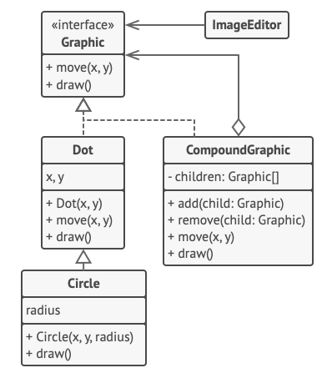
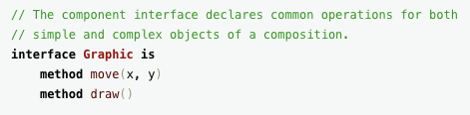
Composite: Class Diagram

Slide 56
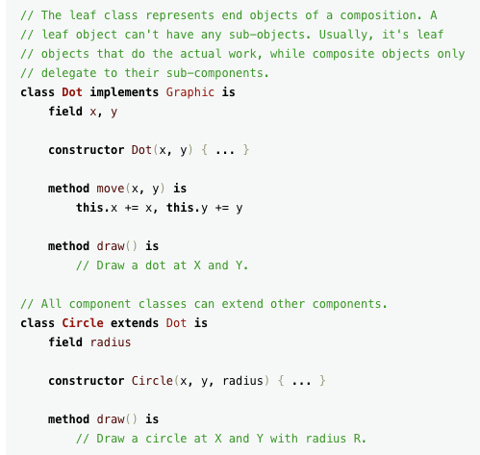
Composite: Class Diagram

Slide 57
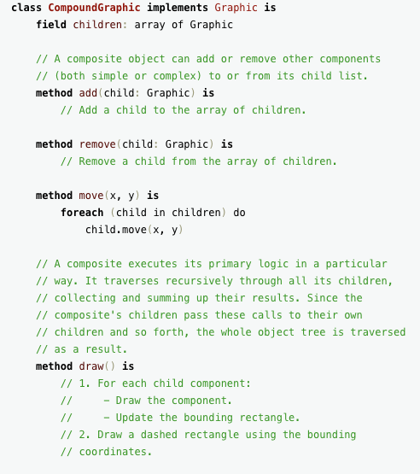
Composite: Class Diagram

Slide 58
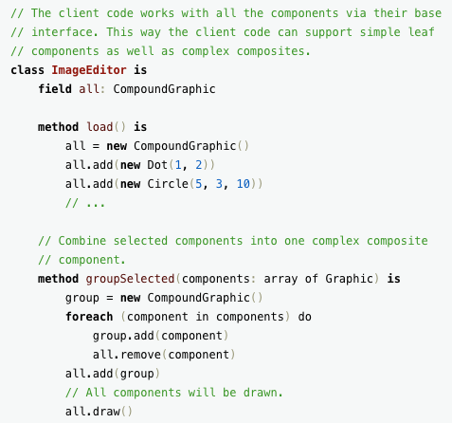
Composite: Class Diagram

Slide 59
Composite: Representing Recursive Hierarchies
Solution:
The Component interface specifies the services that are shared between Leaf and Composite.
A Composite has an aggregation association with Components and implements each service by iterating over each contained Component.
The Leaf services do the actual work.

Slide 60
Composite: Consequences
Consequences:
Client uses the same code for dealing with Leaves or Composites.
Leaf-specific behavior can be changed without changing the hierarchy.
New classes of Leaves can be added without changing the hierarchy.

Slide 61
Discussion
Discussion
See the interesting discussion in Wikipedia (2019):
"Use of this pattern makes it possible to interchange concrete classes without changing the code that uses them, even at runtime. However, employment of this pattern, as with similar design patterns, may result in unnecessary complexity and extra work in the initial writing of code."

Slide 62
An Old Exam Question
A company that makes sports equipment decides to create a system for selling sports equipment online. The company already has a product database with specification, marketing information, and prices of the equipment that it manufactures.
To sell equipment online the company will need to create: a customer database, and an ordering system for online customers.
The plan is to develop the system in two phases. During Phase 1, simple versions of the customer database and ordering system will be brought into production. In Phase 2, major enhancements will be made to these components.

Slide 63
An Old Exam Question
Careful design during Phase 1 will help the subsequent development of new components in Phase 2.
For the interface between the ordering system and the customer database:
i Select a design pattern that will allow a gradual transition from Phase 1 to Phase 2.
ii Draw a UML class diagram that shows how this design pattern will be used in Phase 1.
If your diagram relies on abstract classes, inheritance, delegation or similar properties be sure that this is clear on your diagram.

Slide 64
An Old Exam Question
Careful design during Phase 1 will help the subsequent development of new components in Phase 2.
For the interface between the ordering system and the customer database:
i Select a design pattern that will allow a gradual transition from Phase 1 to Phase 2.
Bridge design pattern
ii Draw a UML class diagram that shows how this design pattern will be used in Phase 1.
If your diagram relies on abstract classes, inheritance, delegation or similar properties be sure that this is clear on your diagram.

Slide 65
An Old Exam Question
Careful design during Phase 1 will help the subsequent development of new components in Phase 2.
For the interface between the ordering system and the customer database:
i Select a design pattern that will allow a gradual transition from Phase 1 to Phase 2.
Bridge design pattern
ii Draw a UML class diagram that shows how this design pattern will be used in Phase 1.
If your diagram relies on abstract classes, inheritance, delegation or similar properties be sure that this is clear on your diagram.
[See next slide]

Slide 66
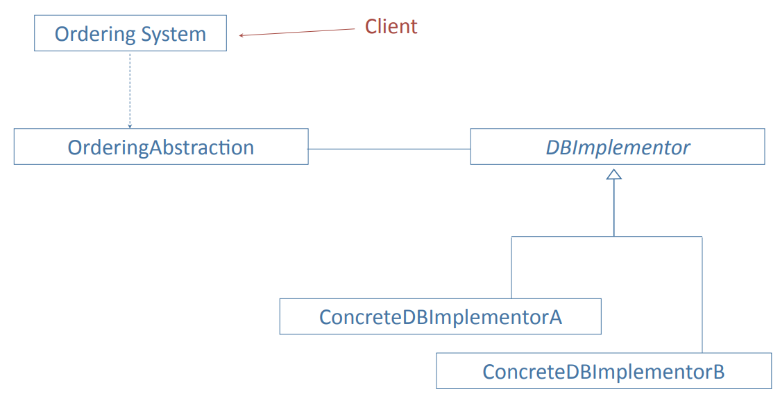
An Old Exam Question

Slide 67
An Old Exam Question
(c) How does this design pattern support:
i Enhancements to the ordering system in Phase 2?
ii A possible replacement of the customer database in Phase 2?

Slide 68
An Old Exam Question
(c) How does this design pattern support:
i Enhancements to the ordering system in Phase 2?
By subclassing OrderingAbstraction
ii A possible replacement of the customer database in Phase 2?

Slide 69
An Old Exam Question
(c) How does this design pattern support:
i Enhancements to the ordering system in Phase 2?
By subclassing OrderingAbstraction
ii A possible replacement of the customer database in Phase 2?
By allowing several ConcreteDBImplementor classes (with Adapter pattern)

Slide 70
Legacy Systems
Many data intensive systems, e.g., those used by banks, universities, etc. are legacy systems. They may have been developed forty years ago as batch processing, master file update systems and been continually modified.
Recent modifications might include customer interfaces for the web, smartphones, etc.
The systems will have migrated from computer to computer, across operating systems, to different database systems, etc.
The organizations may have changed through mergers, etc.
Maintaining a coherent system architecture for such legacy systems is an enormous challenge, yet the complexity of building new systems is so great that it is rarely attempted.

Slide 71
Legacy Systems
The Worst Case
A large, complex system that was developed several decades ago:
Widely used either within a big organization or by an unknown number of customers.
All the developers have retired or left.
No list of requirements. It is uncertain what functionality the system provides and who uses which functions.
System and program documentation incomplete and not kept up to date.
Written in out-of-date versions of programming languages using system software that is also out of date.
Numerous patches over the years that have ignored the original system architecture and program design.
Extensive code duplication and redundancy.
The source code libraries and production binaries may be incompatible.

Slide 72
Legacy Requirements
Planning
In conjunction with the client develop a plan for rebuilding the system.
Requirements as seen by the customers and users
Who are the users?
What do they actually use the system for?
Does the system have undocumented features that are important or bugs that users rely on?
How many people use the fringe parts of the system? Where are they flexible?
Requirements as implied by the system design
If there is any system documentation, what does it say about the requirements?
Does the source code include any hints about the requirements?
Is there code to support obsolete hardware or services? If so, does anybody still use them?

Slide 73
Legacy Code
Source code management
Use a source code management system to establish a starting version of the source code and binaries that are built from this source code.
Create a test environment so that the rebuilt system can be compared with the current system. Begin to collect test cases.
Check the licenses for all vendor software.

Slide 74
Legacy Code
Rebuilding the software
An incremental software development process is often appropriate, with each increment released when completed.
The following tasks may be tackled in any appropriate order, based on the condition of the code. Usually the strategy will be to work on different parts of the system in a series of phases.
Understand the original systems architecture and program design.
Establish a component architecture, with defined interfaces, even if much of the code violates the architecture and needs adapters.
Move to current versions of programming languages and systems software.
If there are any subsystems that do not have source code, carry out a development cycle to create new code that implements the requirements.
If there is duplicate code, replace with a single version.
Remove redundant code and obsolete requirements.
Clean up as you go along.

Slide 75
02
PART TWO
Reliability

Slide 76
Bugs, Faults, and Failures
Bug (fault):
Programming or design error whereby the delivered system does not conform to specification (e.g., coding error, protocol error)
Failure:
Software does not deliver the service expected by the user (e.g., mistake in requirements, confusing user interface)

Slide 77
Bugs and Features
That's not a bug. That's a feature!
Users will often report that a program behaves in a manner that they consider wrong, even though it is behaving as intended.
That’s not a bug. That’s a failure!
The decision whether this needs to be changed should be made by the client not by the developers.

Slide 78
Terminology
Fault avoidance
Build systems with the objective of creating fault-free (bugfree) software.
Fault detection (testing and verification)
Detect faults (bugs) before the system is put into operation or when discovered after release.
Fault tolerance
Build systems that continue to operate when problems (bugs, overloads, bad data, etc.) occur.

Slide 79
Failure of Requirements
An actual example
Year 2000 Problem

Slide 80
Failures: A Case Study
A passenger ship with 1,509 persons on board grounded on a shoal near Nantucket Island, Massachusetts. At the time the vessel was about 17 miles from where the officers thought they were. The vessel was on a route from Bermuda to Boston.

Slide 81
Case Study: Analysis
From the report of the National Transportation Safety Board:
The ship was steered by an autopilot that relied on position information from the Global Positioning System (GPS).
If the GPS could not obtain a position from satellites, it provided an estimated position based on Dead Reckoning (distance and direction traveled from a known point).
The GPS failed one hour after leaving Bermuda.
The crew failed to see the warning message on the display (or to check the instruments).
34 hours and 600 miles later, the Dead Reckoning error was 17 miles.

Slide 82
Case Study: Software Lessons
All the software worked as specified (no bugs), but ...
After the GPS software was specified, the requirements changed (stand alone system now part of integrated system).
The manufacturers of the autopilot and GPS adopted different design philosophies about the communication of mode changes.
The autopilot was not programmed to recognize valid/invalid status bits in messages from the GPS.
The warnings provided by the user interface were not sufficiently conspicuous to alert the crew.
The officers had not been properly trained on this equipment.
Reliable software needs all parts of the software development process to be carried out well.

Slide 83
Key Factors for Reliable Software
Organization culture that expects quality. This comes from the management and the senior technical staff.
Precise, unambiguous agreement on requirements.
Design and implementation that hides complexity (e.g., structured design, object-oriented programming).
Programming style that emphasizes simplicity, readability, and avoidance of dangerous constructs.
Software tools that restrict or detect errors (e.g., strongly typed languages, source control systems, debuggers).
Systematic verification at all stages of development, including requirements, system architecture, program design, implementation, and user testing.
Particular attention to changes and maintenance.

Slide 84
Building Dependable Systems: Organizational Culture
Good organizations create good systems:
Managers and senior technical staff must lead by example.
Acceptance of the group's style of work (e.g., meetings, preparation, support for juniors).
Visibility.
Completion of a task before moving to the next (e.g., documentation, comments in code).

Slide 85
Building Dependable Systems: Organizational Culture
Example: a library consortium
The problem:
Database crashed repeatedly, losing data.
Successive releases failed to fix the problem.
Analysis:
Team had a good technical plan, but needed time.
Senior management insisted on releases before they were ready.
The fix:
Give the team time.
Change the senior management.

Slide 86
Building Reliable Software: Quality Management Processes
Assumption:
Good software is impossible without good processes
The importance of routine:
Standard terminology (requirements, design, acceptance, etc.)
Software standards (coding standards, naming conventions, etc.)
Regular builds of complete system (often daily)
Internal and external documentation
Reporting procedures
This routine is important for both heavyweight and lightweight development processes.

Slide 87
Building Reliable Software: Quality Management Processes
When time is short...
Pay extra attention to the early stages of the process: feasibility, requirements, design.
If mistakes are made in the requirements process, there will be little time to fix them later.
Experience shows that taking extra time on the early stages will usually reduce the total Ime to release.

Slide 88
Building Reliable Software: Communication with the Client
A system is no use if it does not meet the client's needs
The client must understand and review the agreed requirements in detail.
It is not sufficient to present the client with a specification document and ask him/her to sign off.
Appropriate members of the client's staff must review relevant areas of the design (including operations, training materials, system administration).
The acceptance tests must belong to the client.

Slide 89
Building Reliable Software: Complexity
The human mind can encompass only limited complexity:
Comprehensibility
Simplicity
Partitioning of complexity
A simple component is easier to get right than a complex one.

Slide 90
Building Reliable Software: Change
Changes can easily introduce problems
Change management
Source code management and version control
Tracking of change requests and bug reports
Procedures for changing requirements specifications, designs and other documentation
Regression testing (discussed later)
Release control
When adding new functions or fixing bugs it is easy to write patches that violate the systems architecture or overall program design. This should be avoided as much as possible. Be prepared to modify the architecture to keep a high quality system.

Slide 91
Building Reliable Software: Fault Tolerance
Aim:
A system that continues to operate when problems occur.
Examples:
Invalid input data (e.g., in a data processing application)
Overload (e.g., in a networked system)
Hardware failure (e.g., in a control system)
General Approach:
Failure detection
Damage assessment
Fault recovery
Fault repair

Slide 92
Fault Tolerance: Recovery
Backward recovery
Record system state at specific events (checkpoints). After failure, recreate state at last checkpoint.
Combine checkpoints with system log (audit trail of transactions) that allows transactions from last checkpoint to be repeated automatically.
Recovery software is difficult to test
Example
After an entire network is hit by lightning, the restart crashes because of overload. (Problem of incremental growth.)

Slide 93
Building Reliable Software: Small Teams and Small Projects
Small teams and small projects have advantages for reliability:
Small group communication cuts need for intermediate documentation, yet reduces misunderstanding.
Small projects are easier to test and make reliable.
Small projects have shorter development cycles. Mistakes in requirements are less likely and less expensive to fix.
When one project is completed it is easier to plan for the next.
Improved reliability is one of the reasons that agile development has become popular over the past few years.

Slide 94
Reliability Metrics
Reliability
Probability of a failure occurring in operational use.
Traditional measures for online systems
Mean Ime between failures
Availability (up time)
Mean time to repair
Market measures
Complaints
Customer retention

Slide 95
Reliability Metrics for Distributed Systems
Traditional metrics are hard to apply in multi-component systems:
A system that has excellent average reliability might give terrible service to certain users.
In a big network, at any given moment something will be giving trouble, but very few users will see it.
When there are many components, system administrators rely on automatic reporting systems to identify problem areas.

Slide 96
Metrics: User Perception of Reliability
Perceived reliability depends upon:
user behavior
set of inputs
pain of failure
User perception is influenced by the distribution of failures
A personal computer that crashes frequently, or a machine that is out of service for two days every few years.
A database system that crashes frequently but comes back quickly with no loss of data, or a system that fails once in three years but data has to be restored from backup.
A system that does not fail but has unpredictable periods when it runs very slowly.

Slide 97
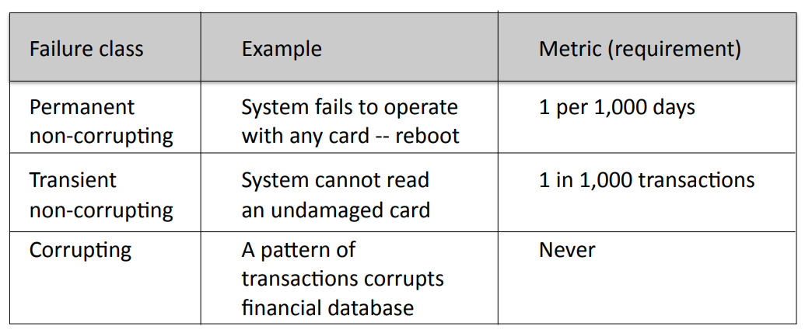
Reliability Metrics for Requirements
Example: ATM card reader

Slide 98
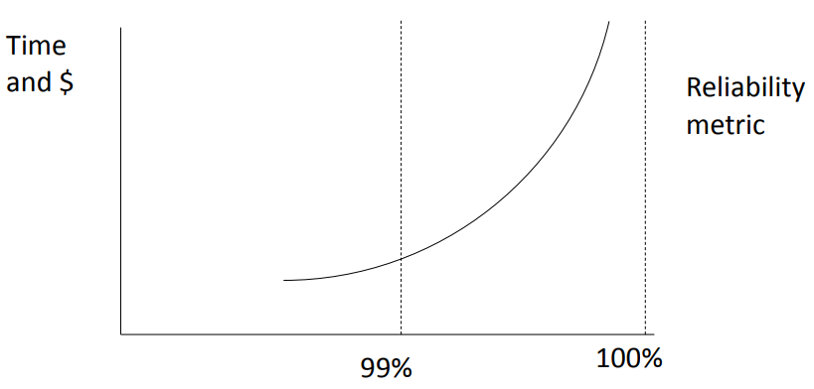
Metrics: Cost of Improved Reliability
Example.
Many supercomputers average 10 hours productive work per day. How do you spend your money to improve reliability?

Slide 99
Example: Central Computing System
A central computer system (e.g., a server farm) is vital to an entire organization (e.g., an Internet shopping site). Any failure is serious.
Step 1: Gather data on every failure
Create a database that records every failure
Analyze every failure:
hardware
software (default)
environment (e.g., power, air conditioning) human (e.g., operator error)

Slide 100
Example: Central Computing System
Step 2: Analyze the data
Weekly, monthly, and annual statistics
Number of failures and interruptions
Mean time to repair
Graphs of trends by component, e.g.,
Failure rates of disk drives
Hardware failures after power failures
Crashes caused by software bugs in each component
Categories of human error

Slide 101
Example: Central Computing System
Step 3: Invest resources where benefit will be maximum, e.g.,
Priority order for software improvements
Changed procedures for operators
Replacement hardware
Orderly restart after power failure

